Slide 1
Introduction to Cryptography

Slide 2
What is Cryptography?
It is the study of secure communications techniques that allow only the sender and intended recipient of a message to view its contents

Slide 3
Encoding and Encryption
Encoding:
It is the process of putting a sequence of characters into a special format for transmission or storage purposes
Encryption:
It is the process of translation of data into a secret code. Encryption is the most effective way to achieve data security. To read an encrypted file, you must have access to a secret key or password that enables you to decrypt it.

Slide 4
Encoding
Base: The total number of unique elements we can use to represent data in an encoding format.
Common Encoding Formats:
ASCII - American Standard Code for Information Interchange (a-z,A-Z,0-9)
A-Z - 65-90
a-z - 97-122
0-9 - 48-57
Binary - Base 2 (0, 1)
Hex - Base 16 (0-9, a-f)
Base 64 - (A-Z, a-z, 0-9, +, /)

Slide 5
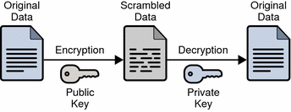
Encryption
Basic Terms:
Plain text: The original message that is sent.
Cipher text: Encrypted form of the plain text which doesn’t have any meaning or is unreadable.
Key: A key iis a piece of information, usually a string of numbers or letters, which, when processed through a cryptographic algorithm, can encrypt or decrypt cryptographic data.

Slide 6
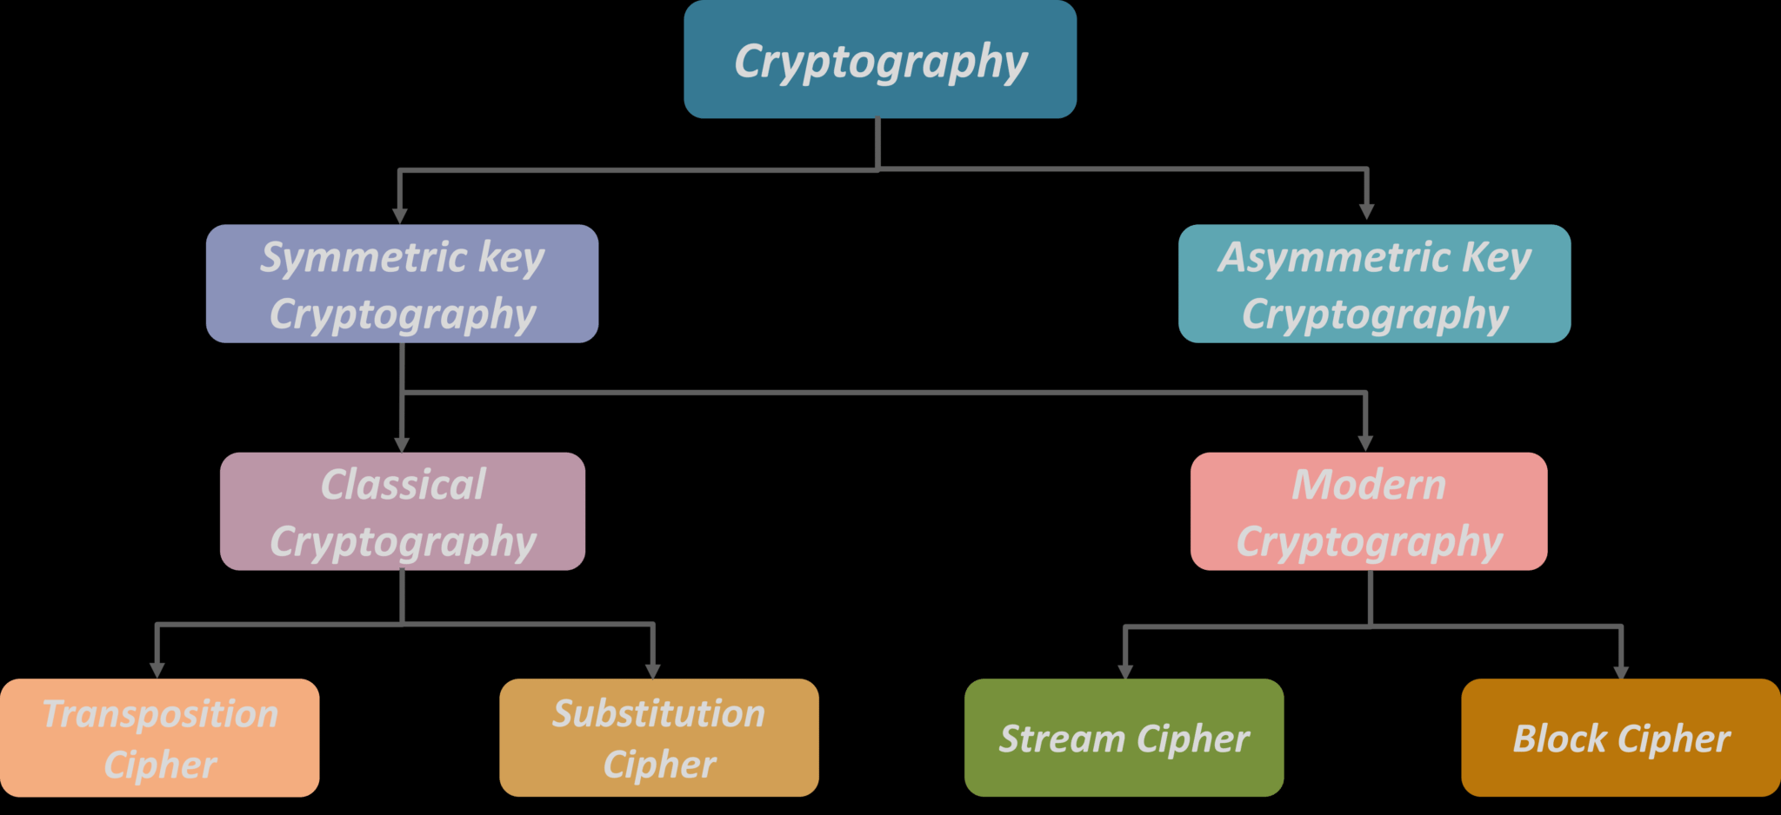
Types of Cryptosystems

Slide 7
Symmetric and Asymmetric Cryptosystems
Symmetric Cryptosystems:
Same key is used for encryption and decryption.
Eg: Caesar cipher, XOR, AES, DES, etc.
Asymmetric Cryptosystems:
DIfferent keys are used for encryption and decryption.
Eg: Diffie-Hellman, ECC, El Gamal, RSA, etc.

Slide 8
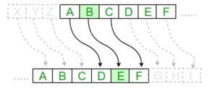
Substitution Cipher
Substitution ciphers encrypt the plaintext by swapping each letter or symbol in the plaintext by a different symbol as directed by the key.
In the above example:
A is substituted by D, B with E and so on.
Here the shift key is 3.

Slide 9

Caesar Cipher
It is a type of substitution cipher in which each letter in the plaintext is 'shifted' a certain number of places down the alphabet.
In the above example the shift key is 1 i.e A is substituted by B and B by C and so on.

Slide 10
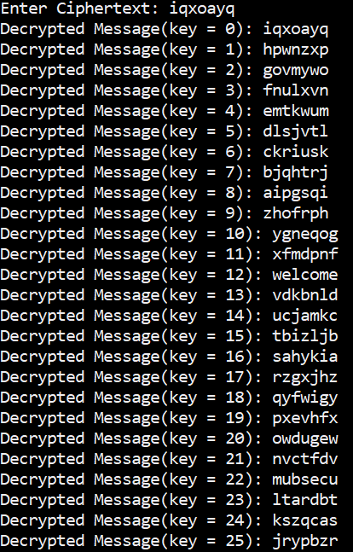
Attacks on Caesar Cipher
Brute Force Attack:
The key space for Caesar cipher is 26 i.e the key has 26 possible values ranging from 0 to 25.
Since the key space is small, brute force attack is a viable option.
In this Example we can see that for key=12 we get a meaningful word.

Slide 11
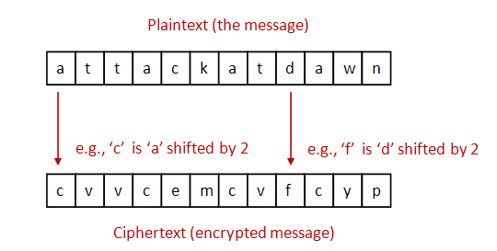
Attacks on Caesar Cipher
Known Plaintext Attack:
KEY = ASCII(Ciphertext - Plaintext)

Slide 12
Modular Arithmetic
When we divide two Integers A and B, we can write the division A/B in the form:
A=BQ+R
Where:
A -> Dividend
B -> Divisor
Q -> Quotient
R -> Remainder

Slide 13
Modulo Operator (%)
From the equation A=BQ+R we can get R by the following operation:
R = A%B or R = A mod B
Eg: 19%15 = 4
The value of R is always between 0 and B i.e 0 <= R < B

Slide 14
Modular Inverse
Given a modular arithmetic A mod B:
Modular inverse of A exists on B if, A and B are co primes i.e GCD(A,B) = 1
If 1 = A*C mod B then C is said to be the modular inverse of A on B.

Slide 15
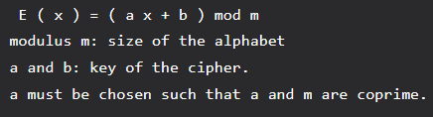

Affine Cipher
The Affine cipher is a type of monoalphabetic substitution cipher, wherein each letter in an alphabet is mapped to its numeric equivalent, encrypted using a simple mathematical function, and converted back to a letter.
Encryption:
Decryption:

Slide 16
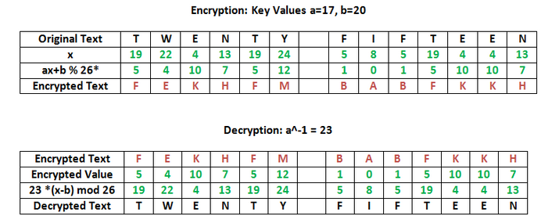
Affine Cipher
Sample Encryption and Decryption:

Slide 17
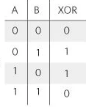
XOR Cipher
It is a stream cipher based on the XOR logic gate.
If the both the inputs are same then the output is low(0) else it is high(1).

Slide 18
XOR Cipher
Since XOR is a stream cipher encryption takes place bitwise.
Consider 10 XOR 15
Convert 10 to binary => 1010 and convert 15 to binary => 1111
10 XOR 15 is 1010 XOR 1111
1010 XOR 1111 is 0101 which is 5
10 | 15 | 10 XOR 15
1 | 1 | 0
0 | 1 | 1
1 | 1 | 0
0 | 1 | 1

Slide 19
Properties of XOR Cipher
XOR is Commutative and Associative:
a XOR b = b XOR a
(a XOR b)XOR c = a XOR (b XOR c)
A XOR A = 0
A XOR 0 = A
If Pt XOR key = Ct then
Pt = Ct Xor key
key = Pt XOR Ct

Slide 20
Single Byte XOR
The entirety of the plaintext is XORed with only a single character.
This makes Single Byte XOR vulnerable to brute force attack.
Plaintext | w | e | l | c | o | m | e
Key | = | = | = | = | = | = | =
Ciphertext | J | X | Q | ^ | R | P | X

Slide 21
Multi Byte XOR
A key of length n is XORed with substring of plaintext of size n.
Provides better security than single byte xor.
Plaintext | W | E | L | C | O | M | E
Key | q | w | e | q | w | e | q
CIphertext | & | 2 | ) | 2 | 8 | ( | 4

Slide 22
Attacks on XOR
Brute Force Attack:
In this approach we try out all possible keys.
In Single Byte XOR, the key length is one byte i.e 8 bits which gives us 2⁸ possibilities.
We XOR the ciphertext with all possible keys and find a resulting plaintext which is human readable.
Known Plaintext Attack:
If we know a part of the plaintext, then we can XOR it with the corresponding part of the ciphertext to get the key.

Slide 23
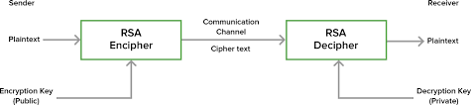
RSA
RSA algorithm is asymmetric cryptography algorithm.
Asymmetric actually means that it works on two different keys i.e. Public Key and Private Key
Public Key is given to everyone and Private key is kept private.

Slide 24
Generating Keys in RSA
Generating Public key:
Select two prime numbers p,q
n = p*q ; n->modulus
phi(n) = (p-1)*(q-1)
Select a integer ‘e’ such that GCD(e,phi(n)) = 1 and 1 < e < phi(n)
Public Key: (e,n)
Generating Private key:
Calculate value of ‘d’:
e*d mod phi(n) = 1 i.e d = modular inverse of e on phi(n)
Private key : (d,n)

Slide 25
Basic RSA Algorithm
Encryption:
M -> plaintext and M < n
C -> ciphertext
C = Me mod n
Decryption:
M = C^{d} mod n

Slide 26
THANK YOU

